Slide 1

Classification Algorithms
Nisal Mihiranga

Slide 2



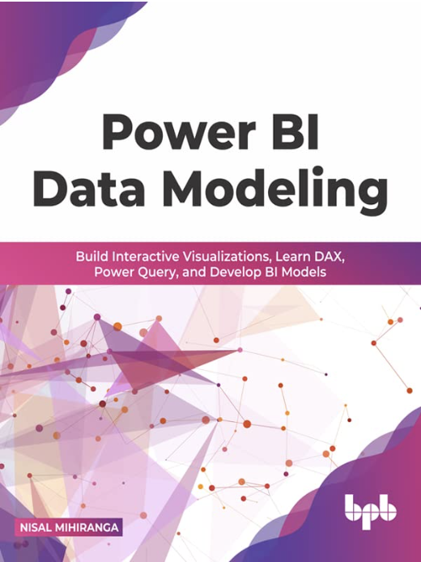
Facilitator
Nisal Mihiranga
Areas of Interest & Expertise:
AI, Technology, Science, Teaching, Consulting, Mentoring
Experience:
Head of AI and Data Science, Architect at
Zone24x7 pvt Ltd
Corporate Trainer
12 Years of Industry exposure to Data Engineering, Data Science and Business Intelligence
Credentials:
M.Sc in Data Science
B.Sc in Information Technology
Microsoft Certified Trainer

Slide 3
Curriculum
Week | Module
Week 1 | Python for Machine Learning
Week 2 | Introduction to Machine Learning
Week 3 | Data Transformation and Analysis
Week 4 | Classification
Week 5 | Regression
Week 6 | Clustering Algorithms
Week 7 | Neural Networks
Week 8 | MLOPS, Machine Learning in Cloud

Slide 4
Learning Outcomes
Understand Key Machine Learning Concepts
Data Preparation and ML Model Training
Implement Classification ML Algorithms
Evaluate Model Performance

Slide 5
Machine Learning

Slide 6
Artificial Intelligence
AI includes everything from rule-based systems (like a simple chess-playing program) to advanced systems that use machine learning or deep learning to make decisions.
AI
Notes:
AI: The simulation of human intelligence in machines designed to think and act like humans.
ML: A subset of AI that enables machines to learn from data and improve their performance over time without being explicitly programmed.

Slide 7
Machine Learning
Machine Learning refers to algorithms that allow computers to learn from data without being explicitly programmed. It relies on statistical techniques to infer patterns from data and make decisions or predictions.
AI
ML
Notes:
AI: The simulation of human intelligence in machines designed to think and act like humans.
ML: A subset of AI that enables machines to learn from data and improve their performance over time without being explicitly programmed.

Slide 8




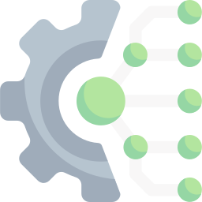


How to build a Model
+
+
=
Data
Algorithms
Training
AI Model
Compute Infrastructure

Slide 9
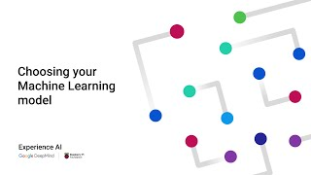
Watch the video on YouTube

Slide 10
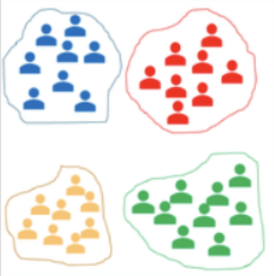
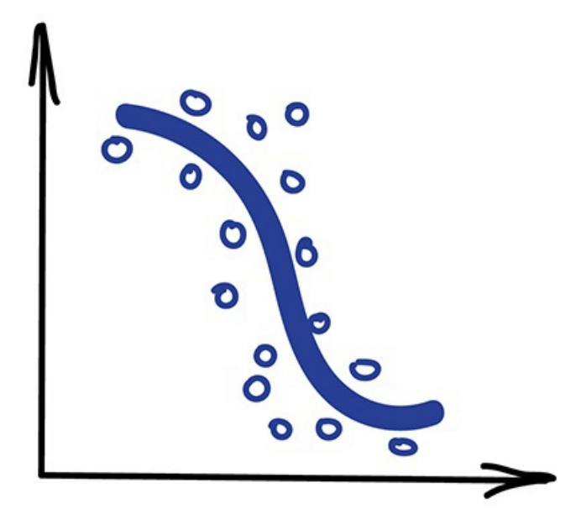
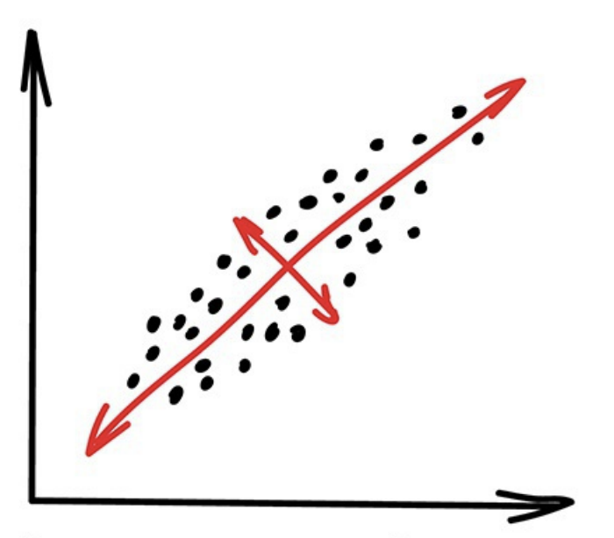
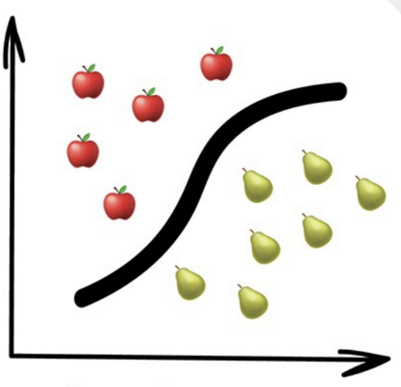
Machine Learning
Has labels
No labels
Unsupervised Learning
Supervised Learning
Categorical
Continuous
Clustering
Dimensionality Reduction
Classification
Regression

Slide 11
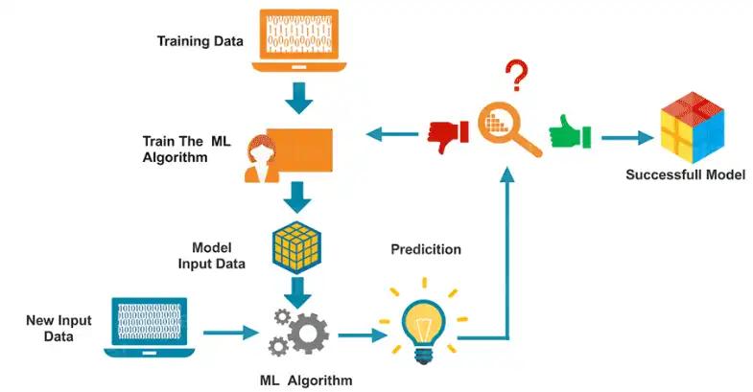
Machine Learning Process

Slide 12
Data Splitting
Data Splitting is a fundamental concept in machine learning used to evaluate the performance of a model. The process involves dividing a dataset into two main subsets: the training set and the testing set.
Used to train the machine learning model. The model learns the relationships between the input features and the target variable from this subset.
Used to evaluate the performance of the trained model. It provides an unbiased assessment of how well the model generalizes to new, unseen data.
Training set
Testing set

Slide 13
https://mlu-explain.github.io/train-test-validation/

Slide 14
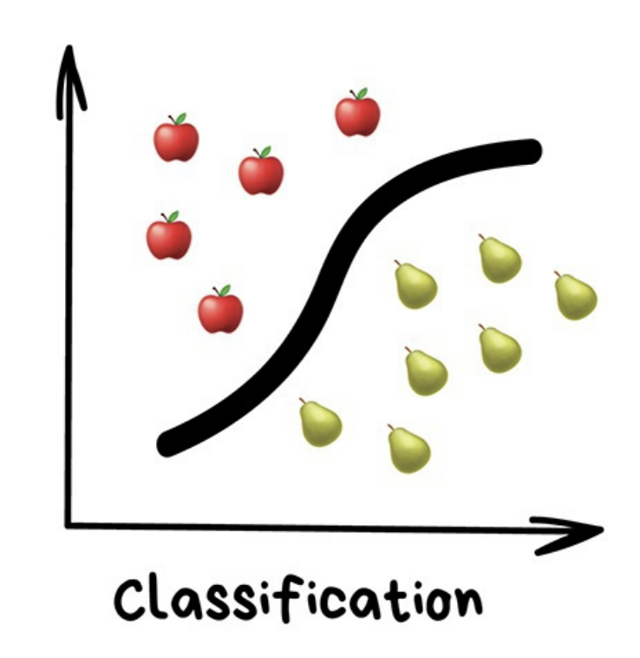
Supervised Learning Classification
In supervised learning, models learn by examples.
Then model tries to predict the correct labels of a given input data.
Notes:
the machine has a "supervisor" or a "teacher" who gives the machine all the answers, like whether it's a cat in the picture or a dog. The teacher has already divided (labeled) the data into cats and dogs, and the machine is using these examples to learn. One by one. Dog by cat.

Slide 15
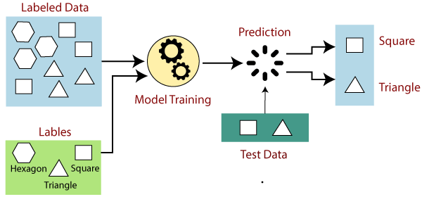

Slide 16
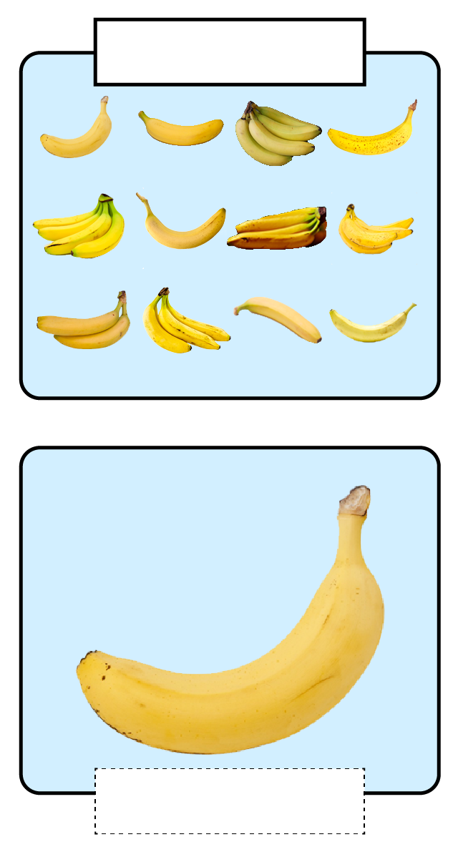
Classification
Banana
Classification is the process of assigning data to a class by applying labels.
A classification model is trained with pre-labelled data.
The model can then be used to
Class
Label
Banana

Slide 17
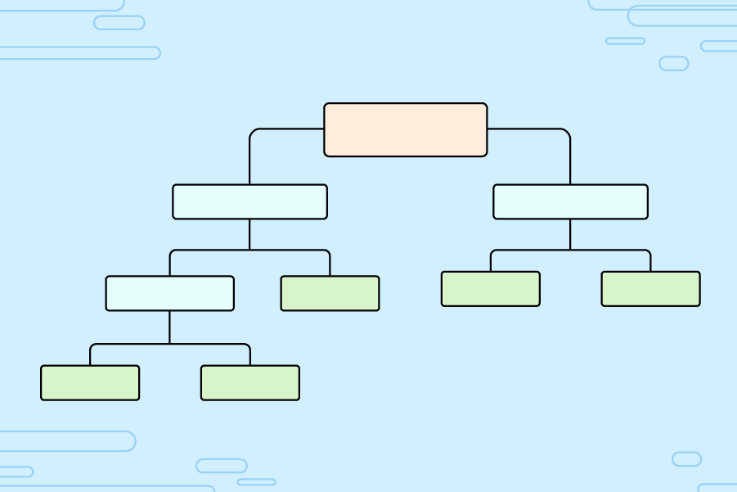
A decision tree
Activity 1
Decision trees are a type of model that are created using supervised learning and can be used to classify data.
Decision trees are made up of nodes.
The top node of a decision tree is called the root.
True
Root
1st decision node
False
Decision node
Decision node
True
False
True
False
Decision node
Leaf
Leaf
Leaf
True
False
Leaf
Leaf
Notes:
Image source: Raspberry Pi Foundation

Slide 18
A decision tree
Activity 1
The nodes in a decision tree are either…
A decision node
A leaf
Decision nodes contain conditions that will split the data, commonly in two directions.
The root is the first decision node.
True
Root
1st decision node
False
Decision node
Decision node
True
False
True
False
Decision node
Leaf
Leaf
Leaf
True
False
Leaf
Leaf
Notes:
Image source: Raspberry Pi Foundation

Slide 19
A decision tree
Activity 1
Leaf nodes will usually represent a single class.
When data is evaluated using a decision tree, the leaf you end on provides the predicted label for that data.
True
Root
1st decision node
False
Decision node
Decision node
True
False
True
False
Decision node
Leaf
Leaf
Leaf
True
False
Leaf
Leaf
Notes:
Image source: Raspberry Pi Foundation

Slide 20
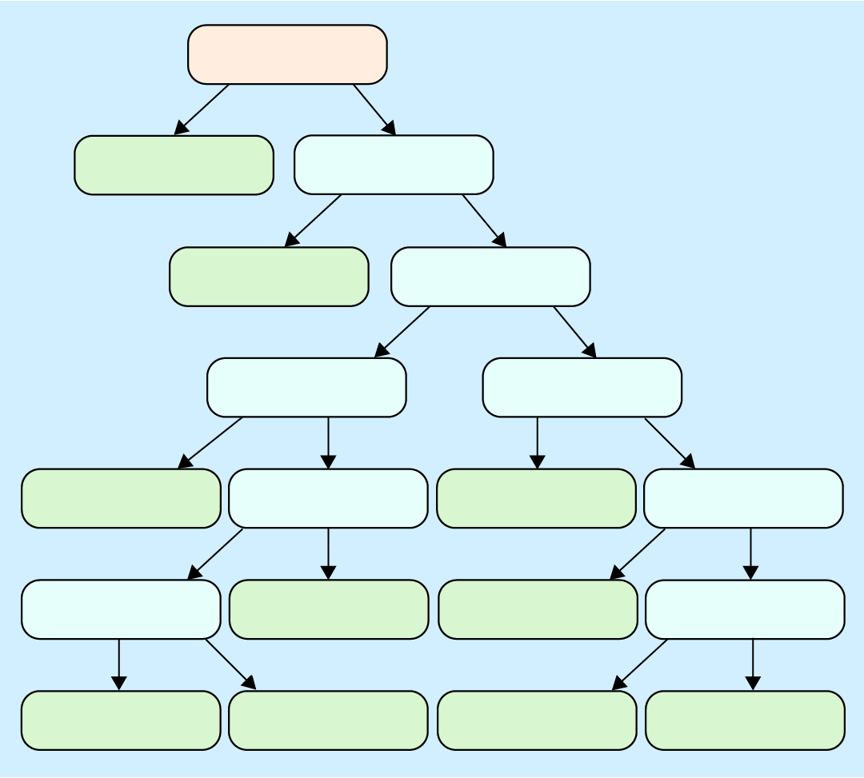
Classifying animals
Activity 1
This decision tree classifies animals.
The data set used to create a decision tree contains features.
Some features are either True or False, such as ‘feathers’, ‘airborne’, or ‘aquatic’.
Other features are numeric, such as ‘number of legs’.
milk = True?
True
False
Mammal
feathers = True?
True
False
Bird
backbone = True?
True
False
fins = True?
airborne = True?
True
False
False
True
Fish
aquatic = True?
Bug
predator = True?
True
False
True
False
eggs = True?
Reptile
Invertebrate
legs <= 2.871?
True
False
True
False
Amphibian
Reptile
Invertebrate
Bug
Notes:
Image source: Raspberry Pi Foundation

Slide 21
What would the prediction be for this animal?
Activity 1
hair | FALSE
feathers | FALSE
eggs | TRUE
milk | FALSE
airborne | FALSE
aquatic | TRUE
predator | TRUE
toothed | TRUE
backbone | TRUE
breathes | FALSE
venomous | FALSE
fins | TRUE
legs | 0
tail | TRUE
domestic | FALSE
cat-sized | TRUE
milk = True?
True
False
Mammal
feathers = True?
True
False
Bird
backbone = True?
True
False
fins = True?
airborne = True?
True
False
False
True
Fish
aquatic = True?
Bug
predator = True?
True
False
True
False
eggs = True?
Reptile
Invertebrate
legs <= 2.871?
True
False
True
False
Amphibian
Reptile
Invertebrate
Bug
Think, pair, share
Notes:
Image source: Raspberry Pi Foundation

Slide 22
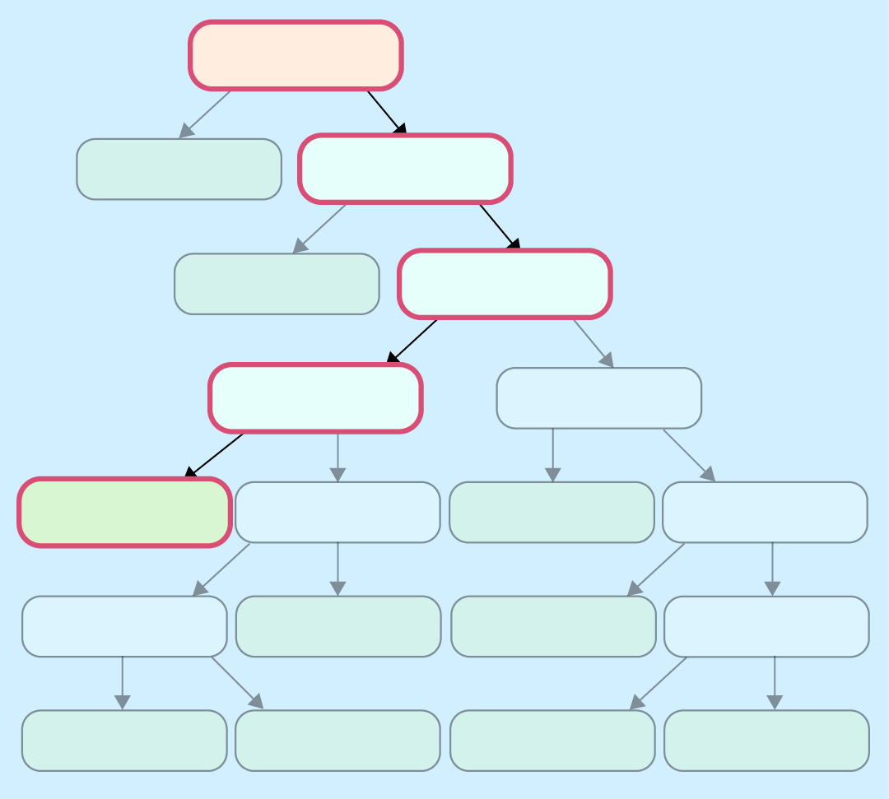
What would the prediction be for this animal?
Activity 1
hair | FALSE
feathers | FALSE
eggs | TRUE
milk | FALSE
airborne | FALSE
aquatic | TRUE
predator | TRUE
toothed | TRUE
backbone | TRUE
breathes | FALSE
venomous | FALSE
fins | TRUE
legs | 0
tail | TRUE
domestic | FALSE
cat-sized | TRUE
milk = True?
True
False
Mammal
feathers = True?
True
False
Bird
backbone = True?
True
False
fins = True?
airborne = True?
True
False
False
True
Fish
aquatic = True?
Bug
predator = True?
True
False
True
False
eggs = True?
Reptile
Invertebrate
legs <= 2.871?
True
False
True
False
Amphibian
Reptile
Invertebrate
Bug
Notes:
Image source: Raspberry Pi Foundation

Slide 23

When to use a decision tree
Activity 1
Decision trees will only work with numeric or categorical data (like True/False).
They do not work with complex data like images, audio, video, or long text data.
Decision trees have a very high level of explainability, because you can follow the conditions to check the cause of a prediction.
milk = True?
True
False
Mammal
feathers = True?
True
False
Bird
backbone = True?
True
False
fins = True?
airborne = True?
True
False
False
True
Fish
aquatic = True?
Bug
predator = True?
True
False
True
False
eggs = True?
Reptile
Invertebrate
legs <= 2.871?
True
False
True
False
Amphibian
Reptile
Invertebrate
Bug
Notes:
Image source: Raspberry Pi Foundation

Slide 24
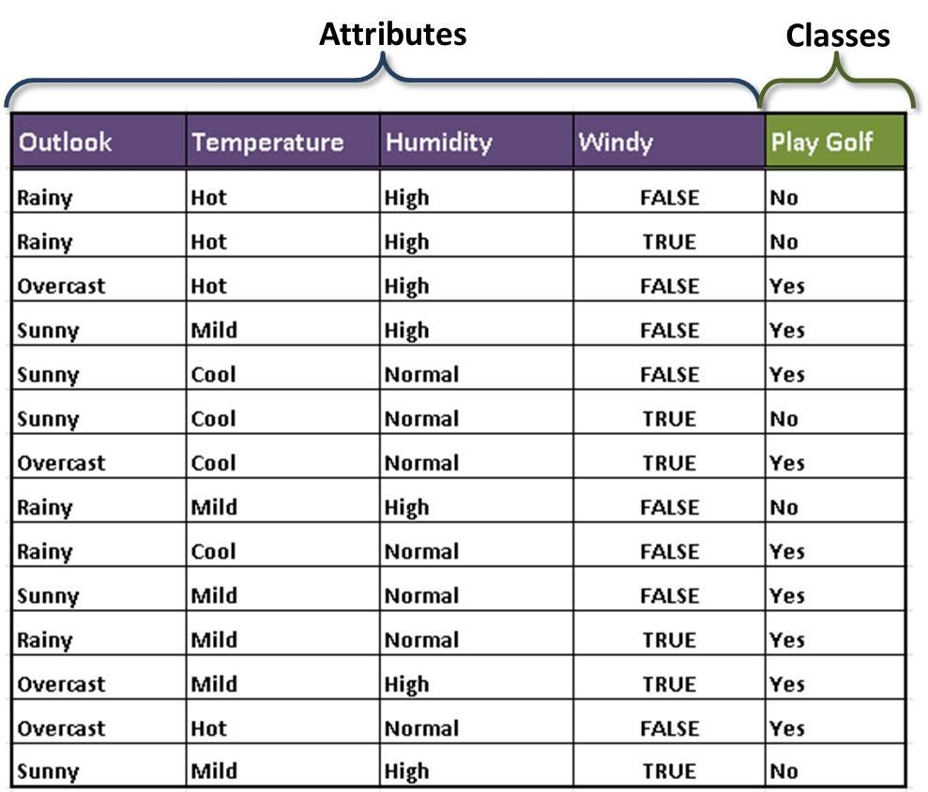

Classification
Features
Labels
Decide to play golf based on the weather condition
Training
Test Data
Notes:
the machine has a "supervisor" or a "teacher" who gives the machine all the answers, like whether it's a cat in the picture or a dog. The teacher has already divided (labeled) the data into cats and dogs, and the machine is using these examples to learn. One by one. Dog by cat.

Slide 25
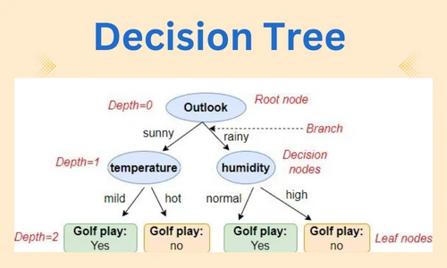
Classification Algorithms

Slide 26

Real-world Applications
Classify Spam Emails

Slide 27
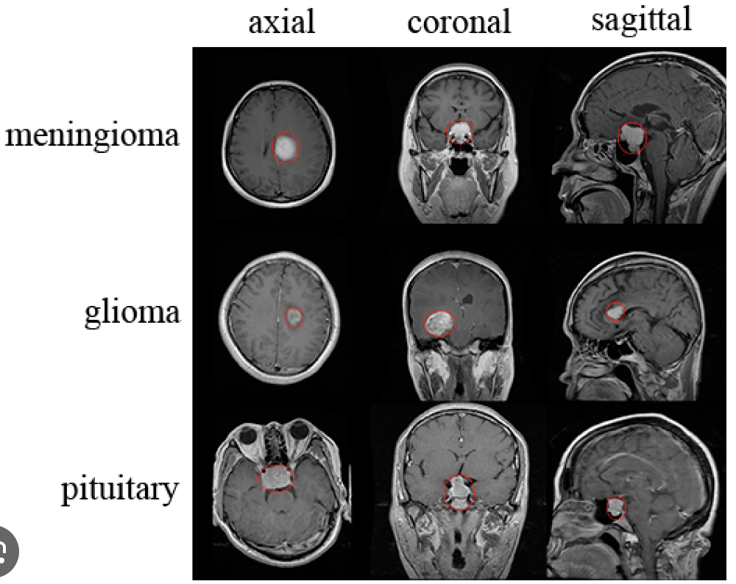
Real-world Applications
Classify brain tumors from MRI

Slide 28


Classification using Decision Tree
Predict survival on the Titanic
https://www.kaggle.com/competitions/titanic/overview

Slide 29
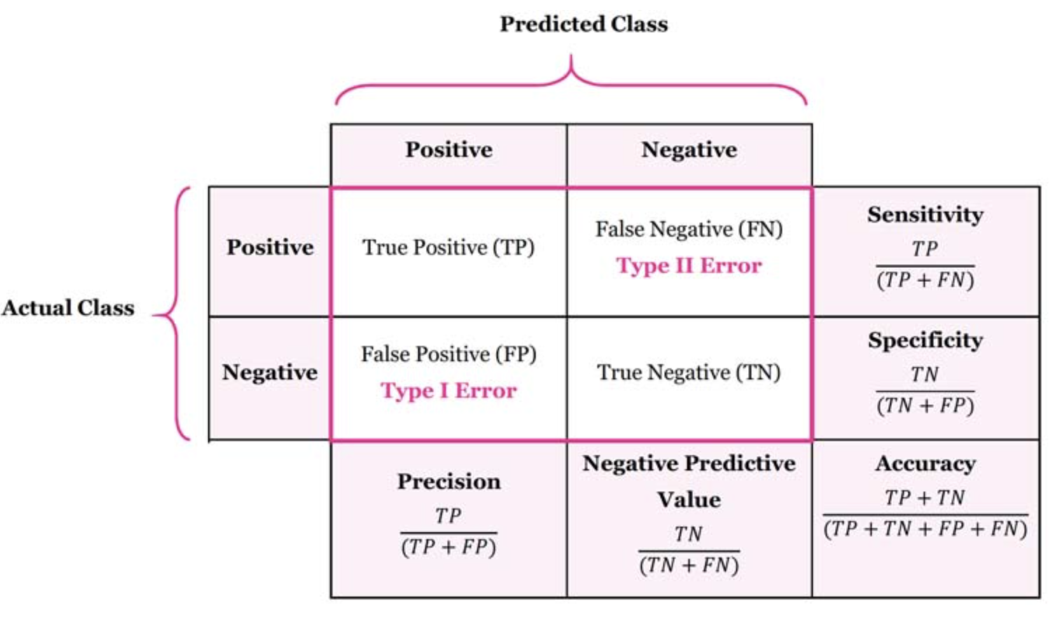
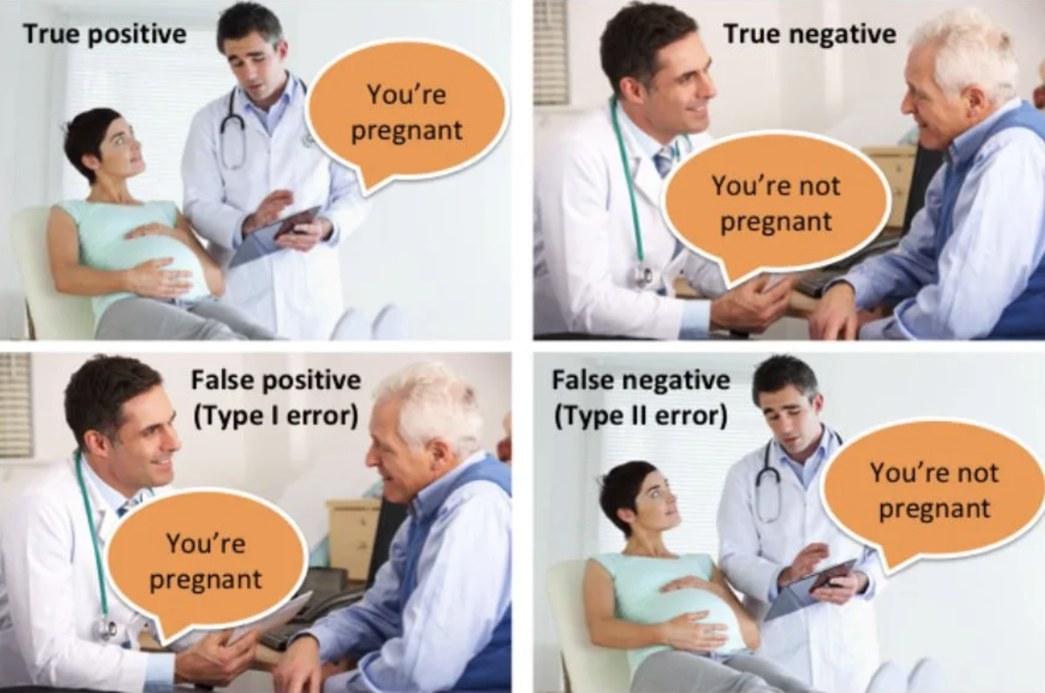
Evaluate Model Performance

Slide 30
Q&A

Slide 31
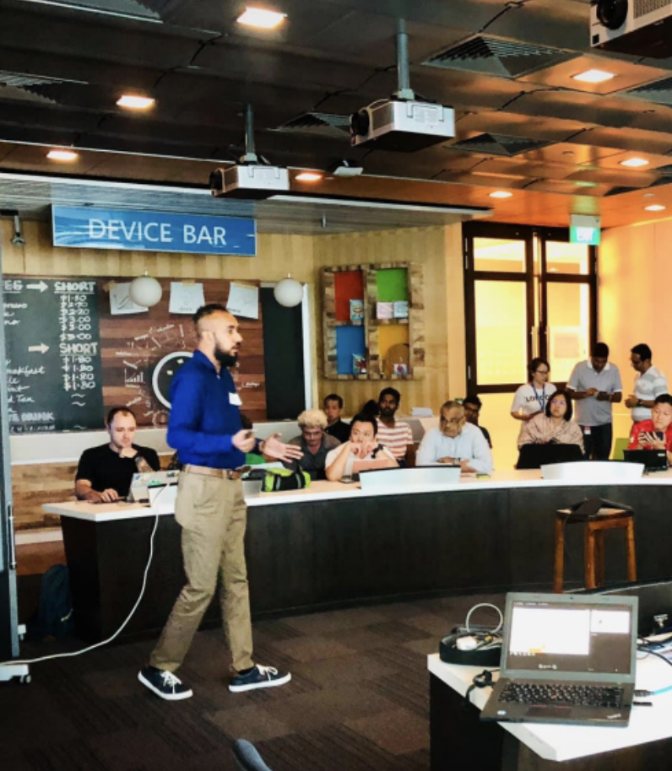




Thank You
Nisal Mihiranga
Head of AI & DS at Zone24x7
Consultant, Trainer
M: +94 71 726 3044

